Slide 1
FUNCTIONAL DECOMPOSTION DIAGRAM

Slide 2
MEDICINES LOCATOR SEARCH ENGINE SYSTEM
REGISTERATION
OF
VENDOR DETAILS
SEARCHING & LOCATING A SPECIFIC MEDICINE
RECORD OF VENDOR INFO.
RECORD OF PHARMACY’S ADMISSION DATA
MEDICINES DATA ENTRY
PROVIDING AVAILABILITY OF MEDICINE
PROVIDING THE LOCATION OF THE MEDICINE

Slide 3
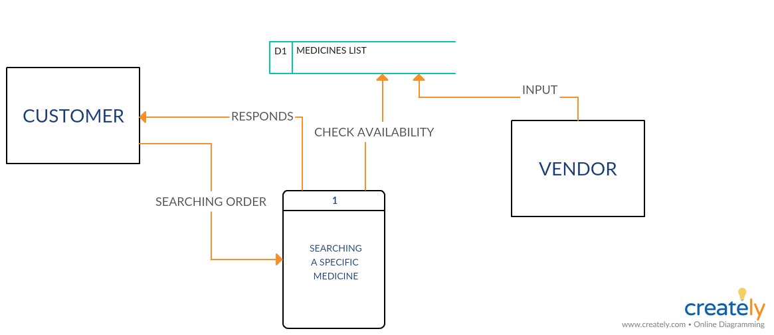
DATA FLOW DIAGRAM (DFD)

Slide 4
Decision Table
 | 1 | 2 | 3 | 4
Supply with more than 380 different drug | Y | Y | N | N
Pharmacy with good feedback | Y | N | Y | N
Be a limited sponsor | X | X
Higher priority in result page | X |  | X

Slide 5
DECISION TREE
Y
Be a sponsor and
Have a higher priority
Have a good feedback?
Y
Be a sponsor
Supplies > 380 different drug?
N
Y
Have a higher priority
N
Have a good feedback?
N

Slide 6
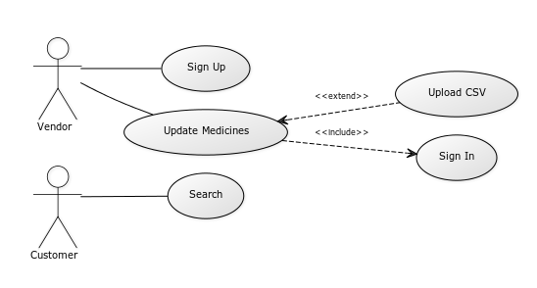
USECASE DIAGRAM

